Slide 1

PRESENTATION ON NETWORK TOPOLOGY AND STAR TOPOLOGY
By ABDUR RAZZAK
ID: 1204149
Batch: ID-NT/ACSL-01M/R28/01
Date: 10/02/2016

Slide 2
At first, we would be known Network Topology
Network topology is the arrangement of the various elements of a computer network.
Essentially, it is the topological structure of a network and may be depicted physically or logically.
Physical topology is the placement of the various components of a network, including device location and cable installation,
while logical topology illustrates how data flows within a network, regardless of its physical design.

Slide 3
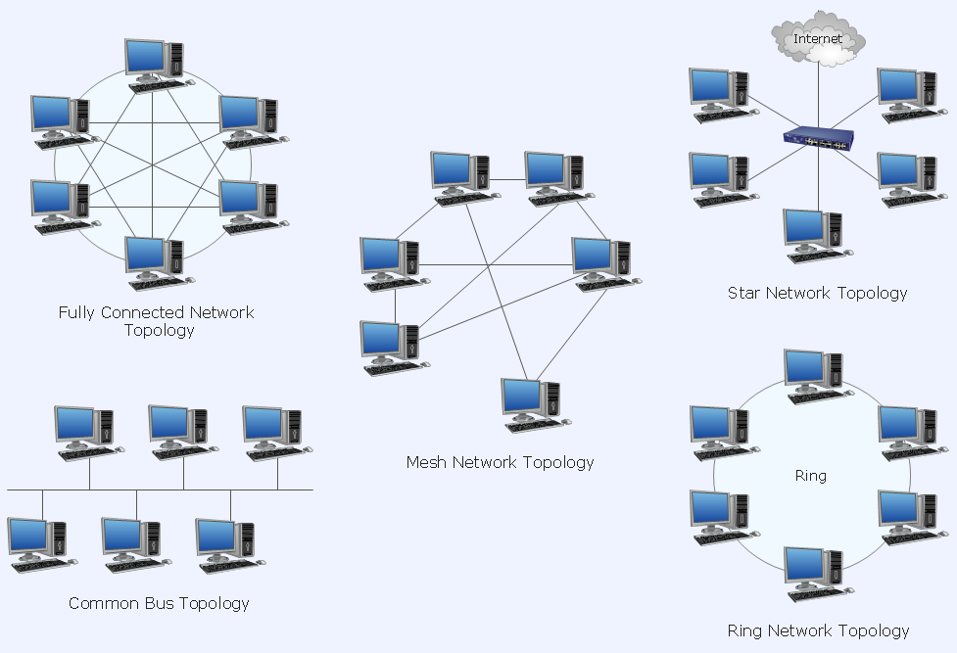
Types of Network topology
There are five primary topologies:
Bus
Star
Ring
Mesh
Hybrid
At this moment we will describe about Star Topology…

Slide 4
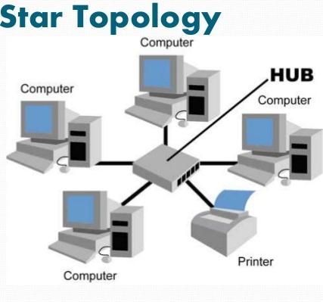
What is Star Topology?
Star topology is one of the most common computer network topology.
In Star topology, all the nodes in the network are connected to a central device called Hub or Switch via cables.
All traffic is controlled by the Hub. Devices transfer data to each other only through the Hub not directly.

Slide 5
Advantages and Disadvantages of Star Topology
Advantages:
Very easy to install and maintain.
New nodes can be added or removed to and from central Hub easily and quickly.
Star networks are very reliable because if any node or cable fails, other nodes are not affected.
Disadvantages:
It requires more cables than other topologies. So it becomes more costly.
This type of network depends upon the central Hub. If the Hub fails, the whole network breaks down.

Slide 6
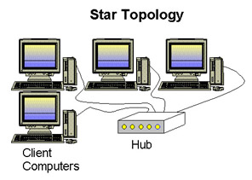
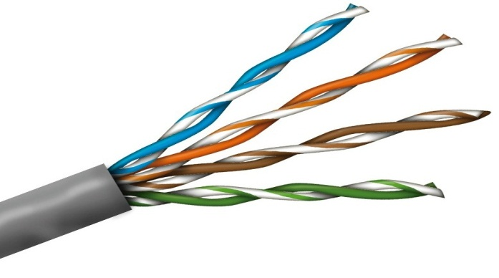
Installing & Configuring
A star configuration is simple: Each of several devices has its own cable that connects to a central hub, or sometimes a switch.
Cabling Ethernet network using unshielded twisted pair (UTP).
At last, sets up IP addresses to the connected computers and checks connectivity using ping command.

Slide 7
Thanks for all…

